Slide 1
Module 8.4 Domain Name System

Slide 2
Domain Name System
DNS
Hierarchical Name Space
root
org
net
edu
com
uk
ca
wisc
ucb
stanford
cmu
mit
cs
ee
www

Slide 3
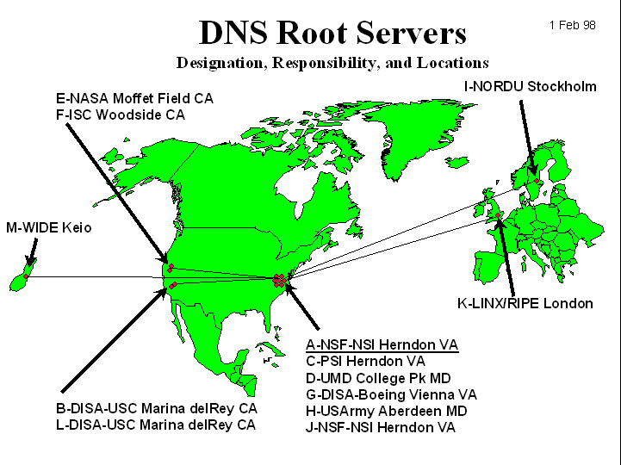
DNS Root Name Servers
Hierarchical service
Root name servers for top-level domains
Authoritative name servers for subdomains
Local name resolvers contact authoritative servers when they do not know a name

Slide 4
DNS Lookup Example
root & edu
DNS server
www.cs.stanford.edu
www.cs.stanford.edu
NS stanford.edu
stanford.edu
DNS server
Local DNS resolver
NS cs.stanford.edu
Client
A www=IPaddr
cs.stanford.edu
DNS server
DNS record types (partial list):
- NS: name server (points to other server)
- A: address record (contains IP address)
- MX: address in charge of handling email
- TXT: generic text (e.g. used to distribute site public keys (DKIM) )

Slide 5
Caching
DNS responses are cached
Quick response for repeated translations
Useful for finding servers as well as addresses
NS records for domains
DNS negative queries are cached
Save time for nonexistent sites, e.g. misspelling
Cached data periodically times out
Lifetime (TTL) of data controlled by owner of data
TTL passed with every record

Slide 6
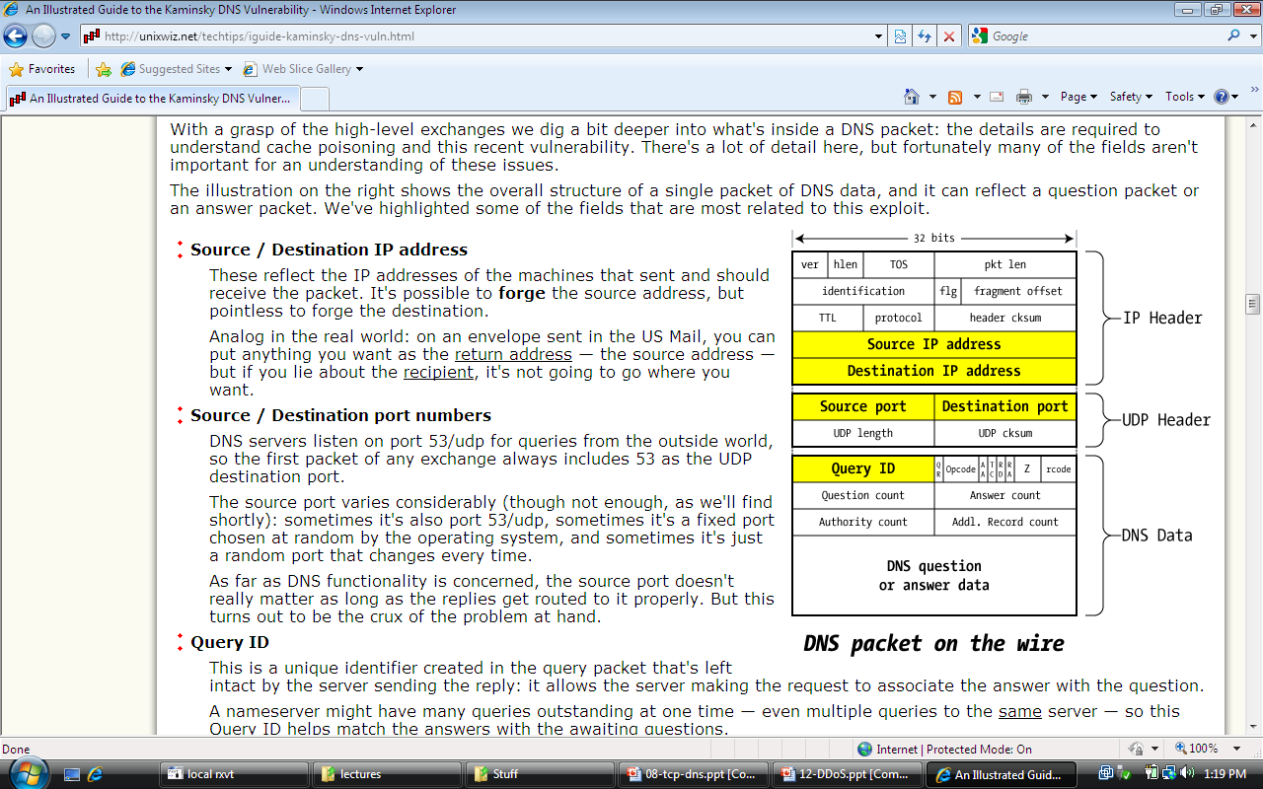
DNS Packet
Query ID:
16 bit random value
Links response to query
(from Steve Friedl)

Slide 7
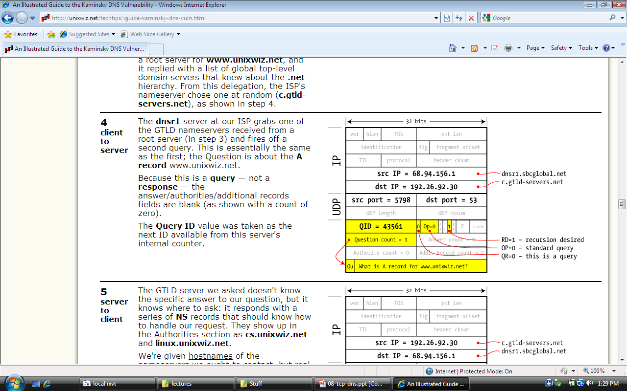
Resolver to NS request
Notes:
SBCglobal DNS resolver wants www.unixwiz.net. First queries C tld server.

Slide 8
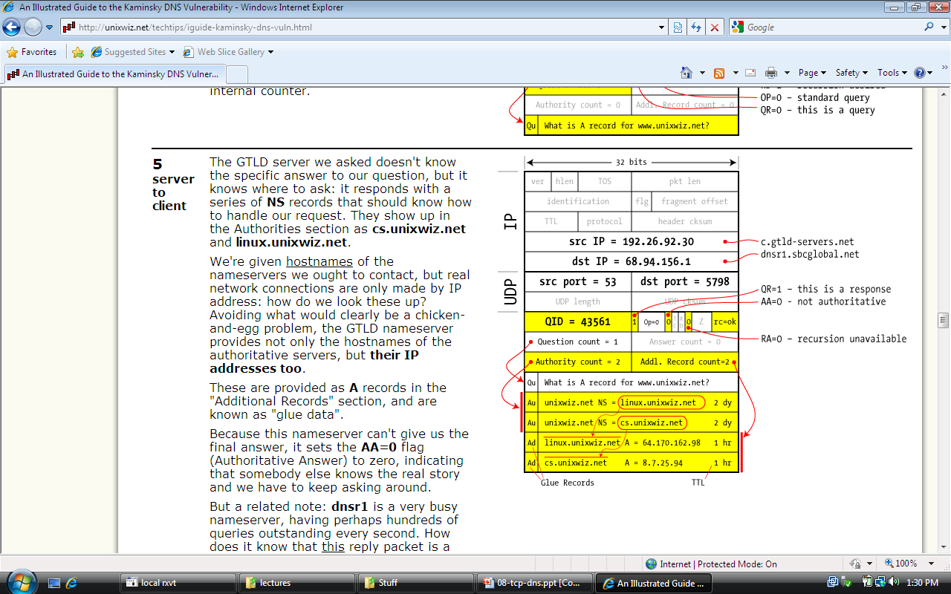
Response to resolver
Response contains IP addr of next NS server
(called “glue”)
Response ignored if unrecognized QueryID
Notes:
Response points to two name servers.

Slide 9
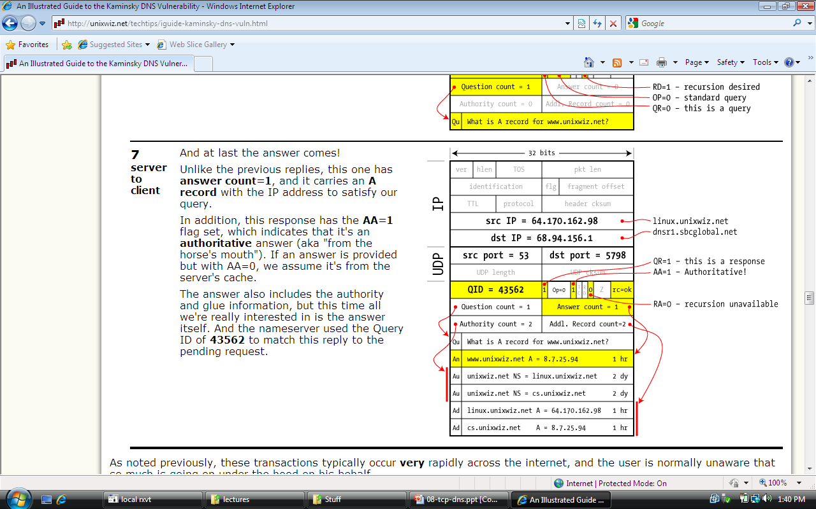
Authoritative response to resolver
bailiwick checking:
response is cached if it is within the same domain of query (i.e. a.com cannot set NS for b.com)
final answer
Notes:
NS linux.unixwiz.net provides the final answer. Response passes bailiwick checking and will be cached.

Slide 10
Basic DNS Vulnerabilities
Users/hosts trust the host-address mapping provided by DNS:
Used as basis for many security policies:
Browser same origin policy, URL address bar
Obvious problems
Interception of requests or compromise of DNS servers can result in incorrect or malicious responses
e.g.: malicious access point in a Cafe
Solution – authenticated requests/responses
Provided by DNSsec … but few use DNSsec

Slide 11
DNS cache poisoning (a la Kaminsky’08)
Victim machine visits attacker’s web site, downloads Javascript
Query:
a.bank.com
a.bank.com
QID=x₁
user
browser
local
DNS
resolver
ns.bank.com
IPaddr
256 responses:
Random QID y₁, y₂, …
NS bank.com=ns.bank.com
A ns.bank.com=attackerIP
attacker
attacker wins if ∃j: x₁ = y_{j}
response is cached and attacker owns IP address being obtained thus

Slide 12
If at first you don’t succeed …
Victim machine visits attacker’s web site, downloads Javascript
Query:
b.bank.com
b.bank.com
QID=x₂
user
browser
local
DNS
resolver
ns.bank.com
IPaddr
256 responses:
Random QID y₁, y₂, …
NS bank.com=ns.bank.com
A ns.bank.com=attackerIP
attacker wins if ∃j: x₂ = y_{j}
response is cached and attacker owns bank.com
attacker
success after ≈ 256 tries (few minutes)
Notes:
Birthday paradox: success once x_{i} = y_{j} for some i,j .
Success probability after each try is 1/256 ⇒ needs 256 tries on average until success

Slide 13
Defenses
Increase Query ID size. How?
Randomize src port, additional 11 bits
Now attack takes several hours
Ask every DNS query twice:
Attacker has to guess QueryID correctly twice (32 bits)
… but Apparently DNS system cannot handle the load

Slide 14
DNS poisoning attacks in the wild
January 2005, the domain name for a large New York ISP, Panix, was hijacked to a site in Australia.
In November 2004, Google and Amazon users were sent to Med Network Inc., an online pharmacy
In March 2003, a group dubbed the "Freedom Cyber Force Militia" hijacked visitors to the Al-Jazeera Web site and presented them with the message "God Bless Our Troops"

Slide 15
DNS Rebinding Attack
[DWF’96, R’01]
<iframe src="http://www.evil.com">
DNS-SEC cannot
stop this attack
Firewall
www.evil.com?
ns.evil.com
DNS server
171.64.7.115 TTL = 0
192.168.0.100
www.evil.com
web server
corporate
web server
171.64.7.115
192.168.0.100
Read permitted: it’s the “same origin”

Slide 16
DNS Rebinding Defenses
Browser mitigation: DNS Pinning
Refuse to switch to a new IP
Interacts poorly with proxies, VPN, dynamic DNS, …
Not consistently implemented in any browser
Server-side defenses
Check Host header for unrecognized domains
Authenticate users with something other than IP
Firewall defenses
External names can’t resolve to internal addresses
Protects browsers inside the organization

Slide 17
Summary
Core protocols not designed for security
Eavesdropping, Packet injection, Route stealing, DNS poisoning
Patched over time to prevent basic attacks
(e.g. random TCP SN)
More secure variants exist (next lecture) :
IP ⟶ IPsec
DNS ⟶ DNSsec
BGP ⟶ SBGP

